Slide 1
TWiLiTE Operations During Polar Winds and Analysis Status
Bruce Gentry¹, Huailin Chen² and Steve Mitchell³
¹NASA/GSFC
²SSAI
³SigmaSpace Corp
Space Wind Lidar Working Group
Miami, FL
November 4, 2015

Slide 2
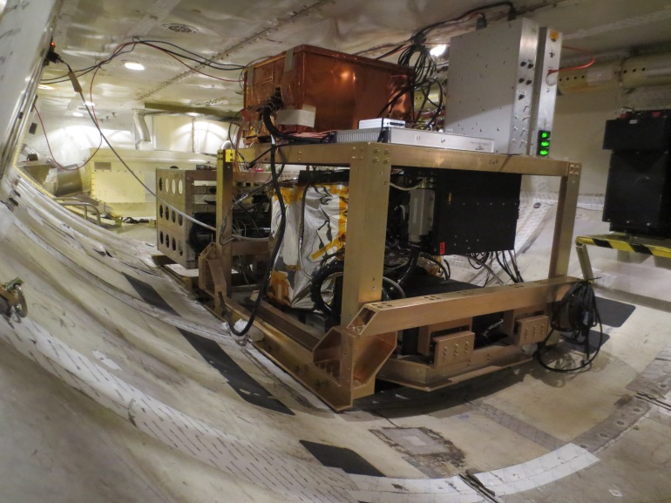
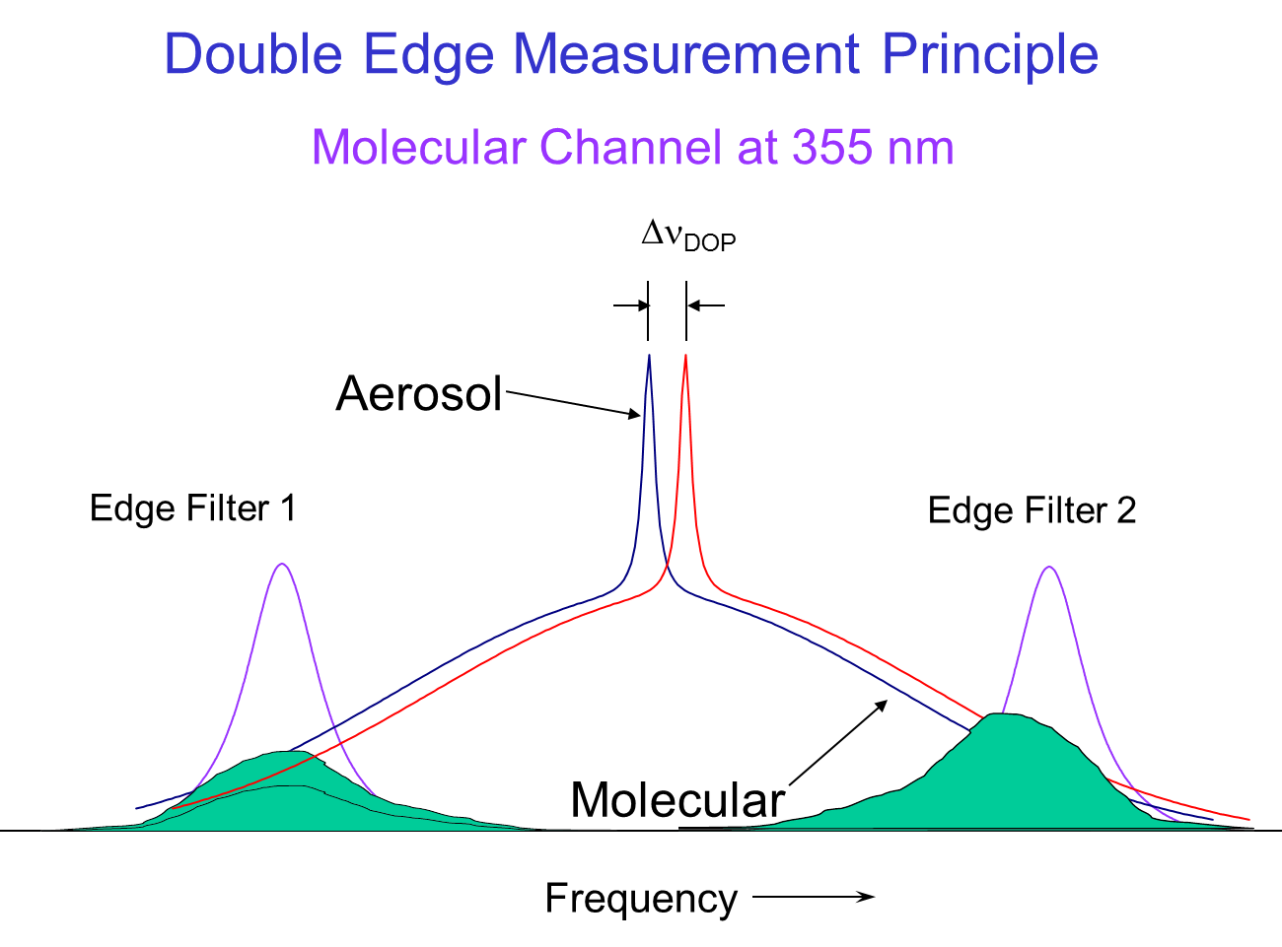
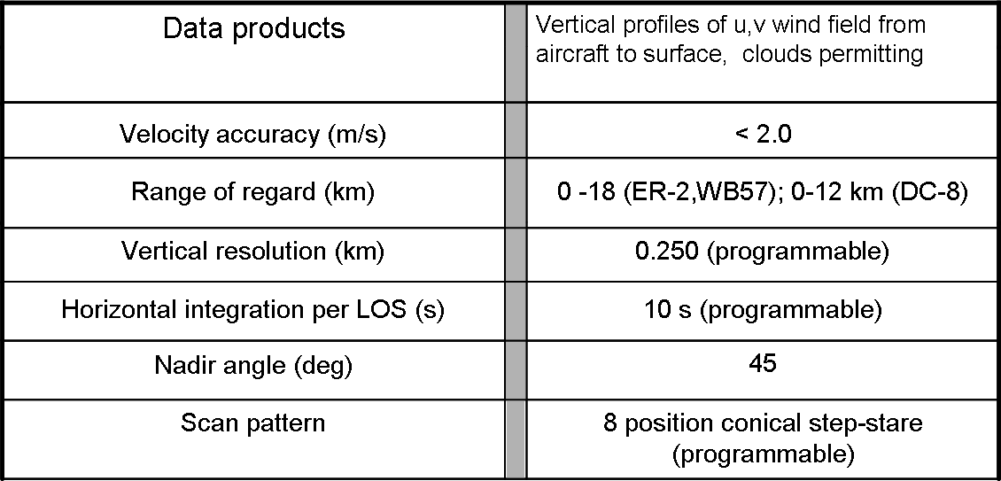
Tropospheric Wind Lidar Technology Experiment – TWiLiTE
TWiLiTE is a compact, molecular direct detection scanning Doppler lidar designed to measure wind profiles in clear air from 20 km to the surface.
TWiLiTE is modular and operates autonomously on NASA research aircraft (ER-2, DC-8, WB-57, Global Hawk).
Engineering flight tests on the NASA ER-2 in 2009, 2011 and 2012 demonstrated autonomous operation of all major systems.
TWiLiTE is now installed in the Nadir 2 port of the DC-8.
TWiLiTE system mounted in the DC-8
TWiLiTE Performance Summary
Notes:
TWiLiTE was developed as an IIP program funded by NASA ESTO. Additional support from the AITT program allowed integration and flight testing on the NASA ER-2.
TWiLiTE Supports the 3DWinds NRC Decadal Survey Mission. It represents the direct detection molecular or ‘clear air’ portion of the recommended ‘Hybrid Doppler lidar concept’. The coherent Doppler lidar utilizes aerosol backscatter a complementery measurement capability and is the other half of the Hybrid concept.
(Lower left panel) The TWiLiTE Doppler lidar operates at 355 nm in the uv and measures wind profiles by measuring the Doppler shift of the laser backscattered return from molecules in the atmosphere using a ‘double edge’ etalon receiver (similar to the ADM-Aeolus molecular channel).
Designed to measure full profiles of horizontal winds from the flight altitude of the NASA ER2 or Global Hawk (20 km) to the surface with 250 m vertical resolution and <2 m/s accuracy
Advances TRL of key technologies identified for future space missions e.g the single frequency uv NdYAG laser; the molecular Doppler receiver; Tunable Fabry-Perot etalon filter and the rotating conically scanned telescope.
These technologies have all been demonstrated at the system level in engineering flights of TWiLiTE on the NASA ER-2 high altitude aircraft in 2009, 2011 and 2012.
TWiLiTE was reconfigured, but not flown, for the NASA Global Hawk as part of the Hurricane and Severe Storm Sentinel (HS3) Venture Class Mission.
Small modifications to the instrument are underway to allow integration on the NASA DC-8 in the Nadir Port 2 location (DAWN goes in Nadir 7).
DC-8 flights are planned in February, 2015 to validate TWiLiTE performance on the DC-8

Slide 3
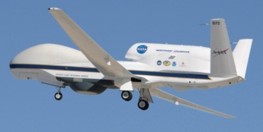
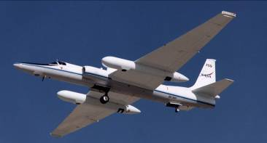
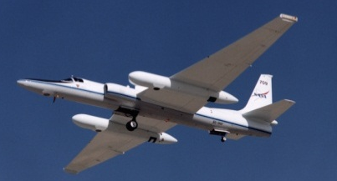
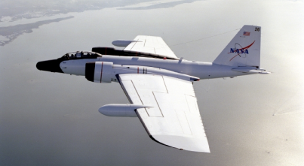
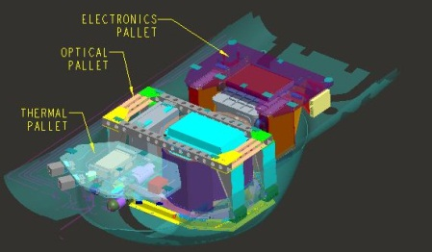
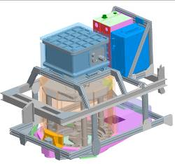
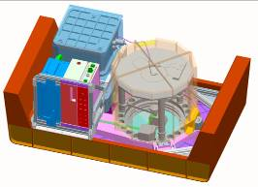
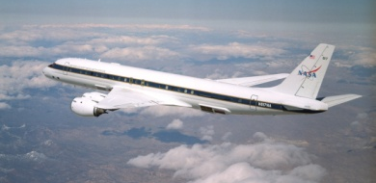
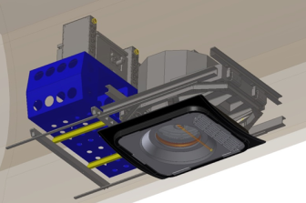
TWiLiTE Compatible
NASA Airborne Science Platforms
36 hrs duration
Unmanned vehicle
6-8 hrs duration
Unattended operation
Global Hawk
25
20
15
10
5
ER2
WB57
TWiLiTE configured for DC8 Nadir Port 2
(AITT)
Max Altitude (km)
DC8
TWiLiTE configured for Global Hawk Zone 25
(HS3)
TWiLiTE configured for WB57 3’ Pallet
(ESTO IIP04)
TWiLiTE configured for ER-2 Q-Bay
(ESTO IIP04)

Slide 4
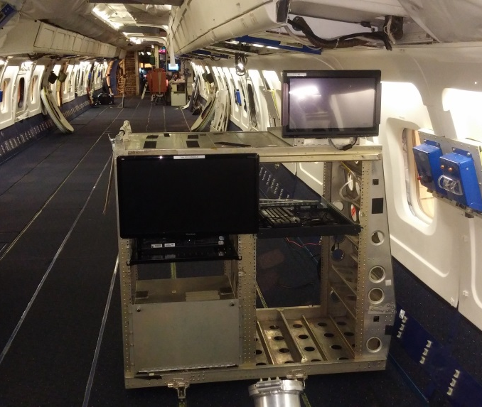
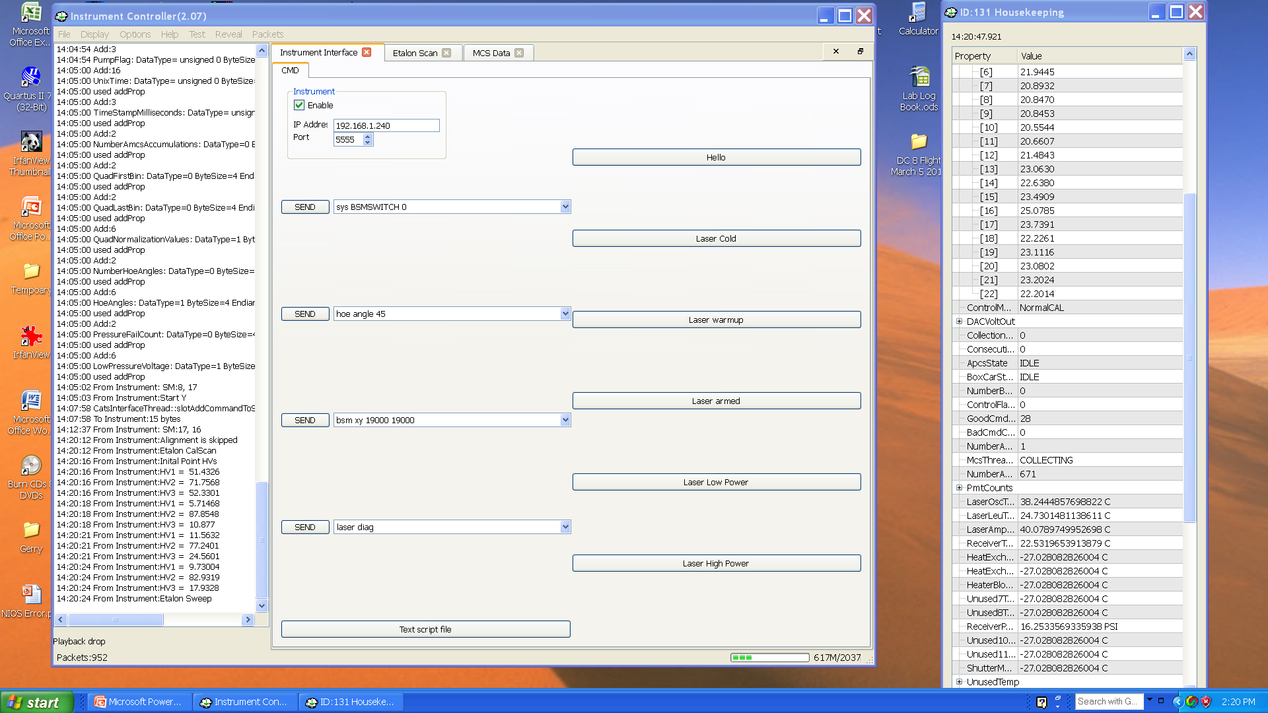
DC-8 Operator Console
Command screen with log on the right and housekeeping data on the left
Single rack with CPU, monitor and KB. Connect to TWiLiTE directly via Ethernet cable.

Slide 5
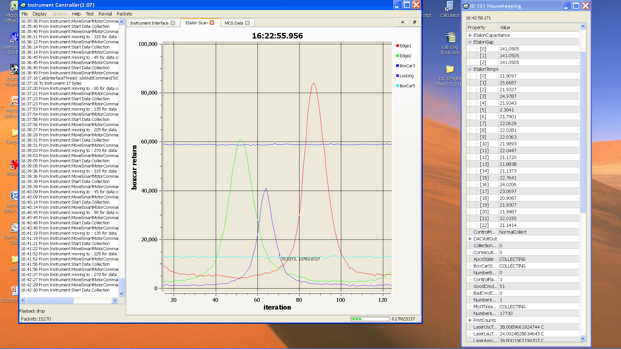
Console – Etalon calibration scan

Slide 6
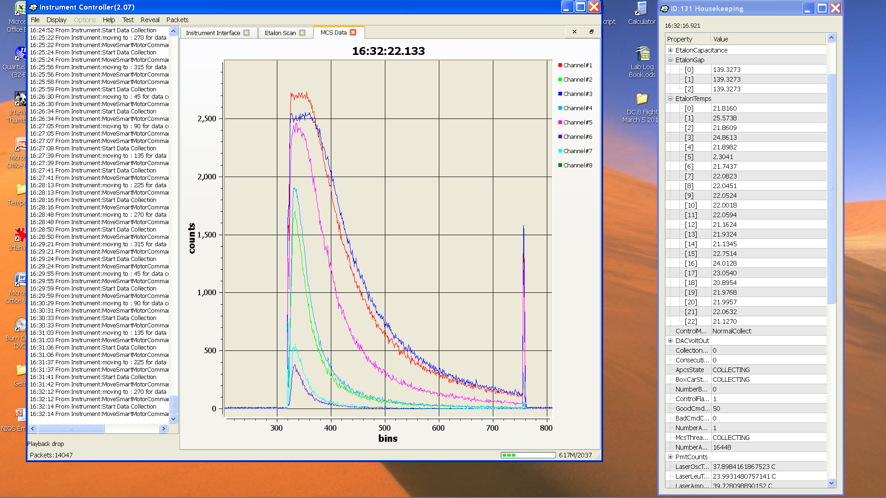
Console – Real time 7-channel PMT signal display

Slide 7
TWiLiTE Operation Summary
Polar Winds- May 9-18, 2015
Date | Scan Cycles | Etalon Calib Sweeps
May 9 | 77 | 14 | Transit to Keflavik
May 11 | 44 | 10 | Etalon T=3 deg C
May 13 | 39 | 8 | Etalon T=7 deg C
May 15 | 46 | 9 | Etalon T=9 deg C
May 16 | 71 | 17 | Etalon T=13 deg C
May 17 | 101 | 10 | Etalon T=6 deg C
May 19 | 62 | 7 | Etalon T=3 deg C
May 21 | 52 | 10 | Etalon T=3 deg C
May 23 | -- | -- | HD error
May 24 | -- | -- | HD error
May 25 | 36 | 7 | Etalon T=7 deg C
May 28 | 109 | 14 | Transit back to DFRC

Slide 8
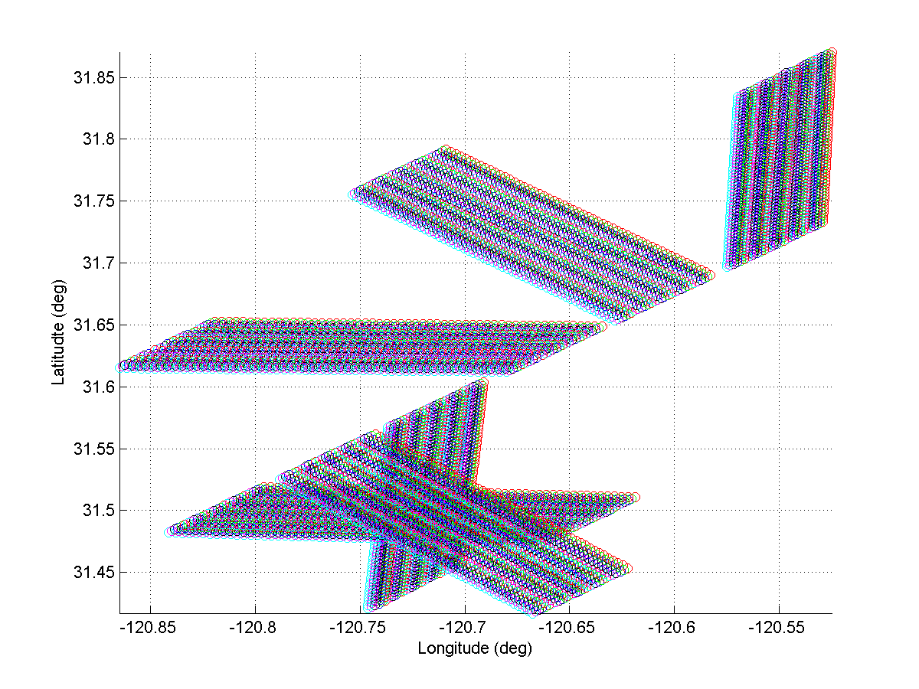
Step Stare Azimuth Scanning and Sampling
Aircraft heading
45
315
90
270
135
225
6 direction step stare scanning.
The HOE is rotated CCW to each of the 6 directions. Dwell at each direction is 30 sec. ~3 sec to move and settle
Shot pattern in Earth-relative rotated
reference frame.

Slide 9
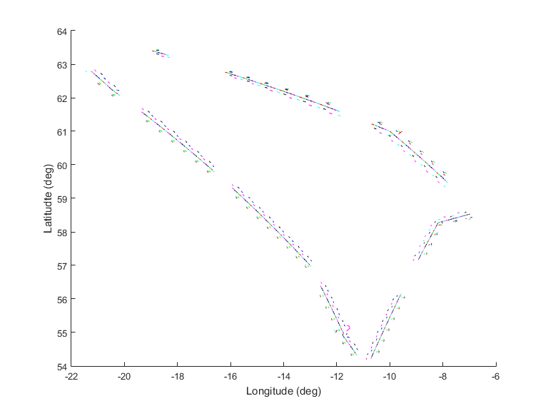
May 15, 2015 Polar Winds Flight track with TWiLiTE scans
Complete scans: 46
Partial scans: 2
Etalon cals: 9

Slide 10
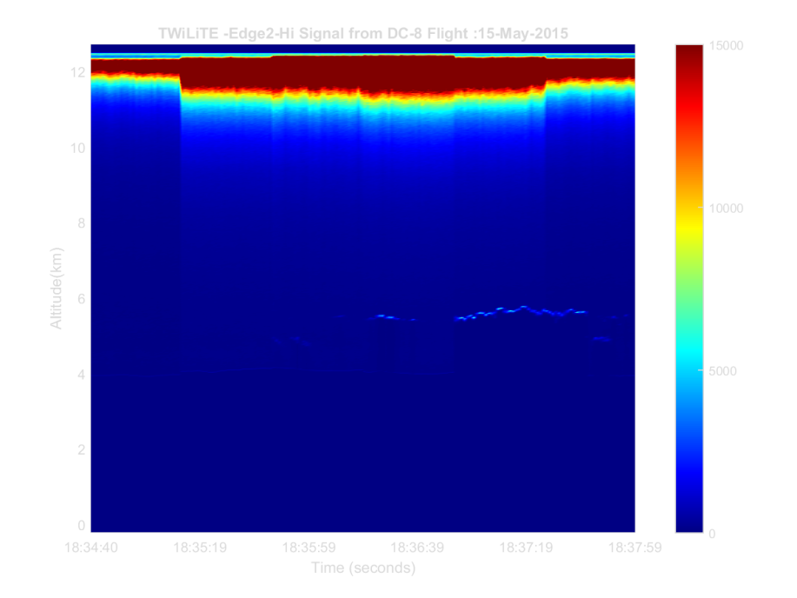
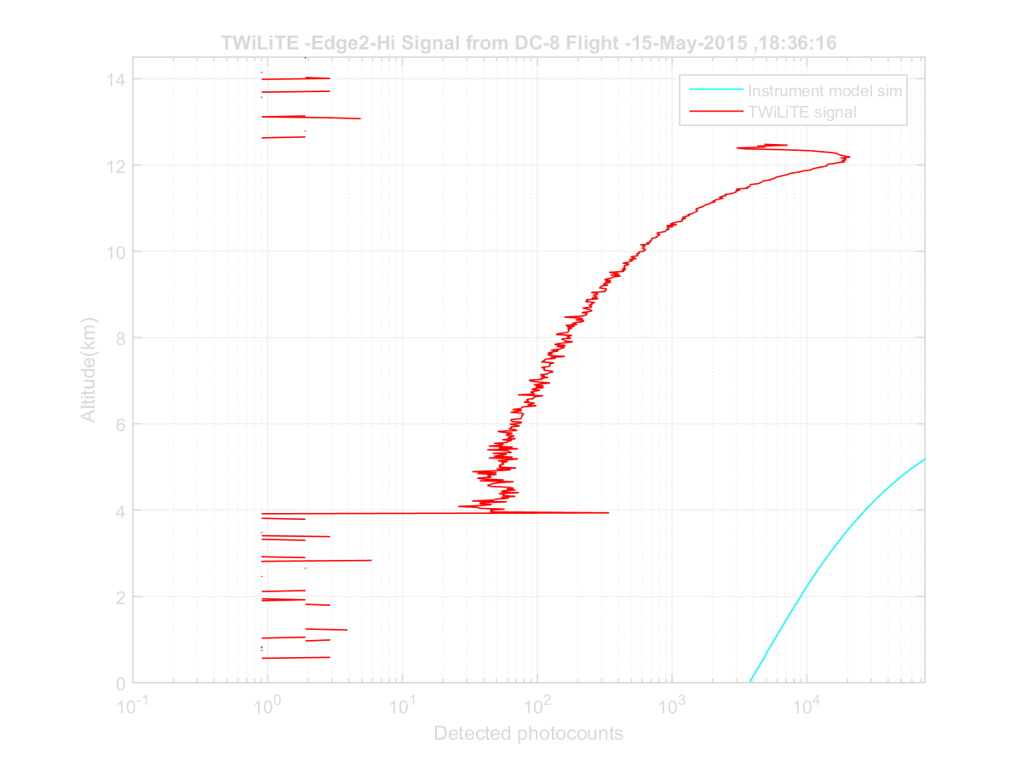
Edge 1 – Hi Signal ~ 90%
May 15, 2015 Cycle 26

Slide 11
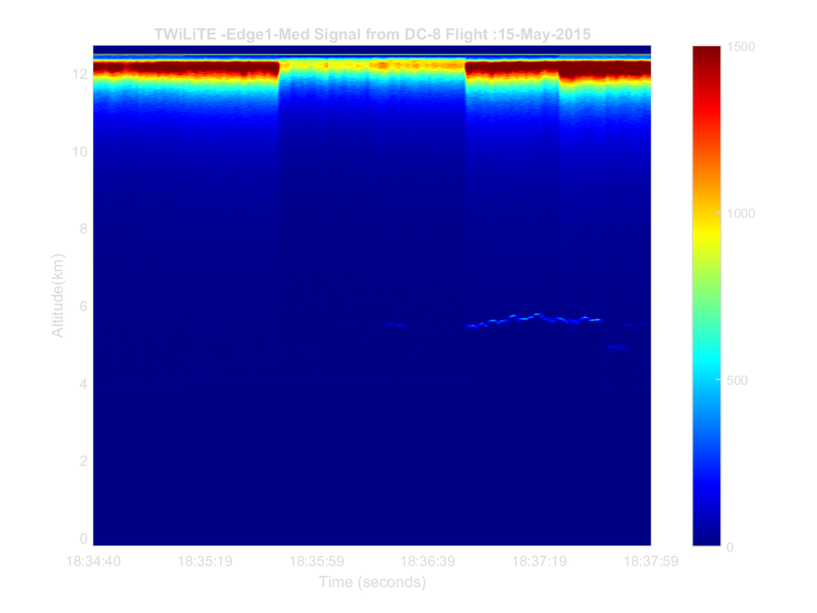
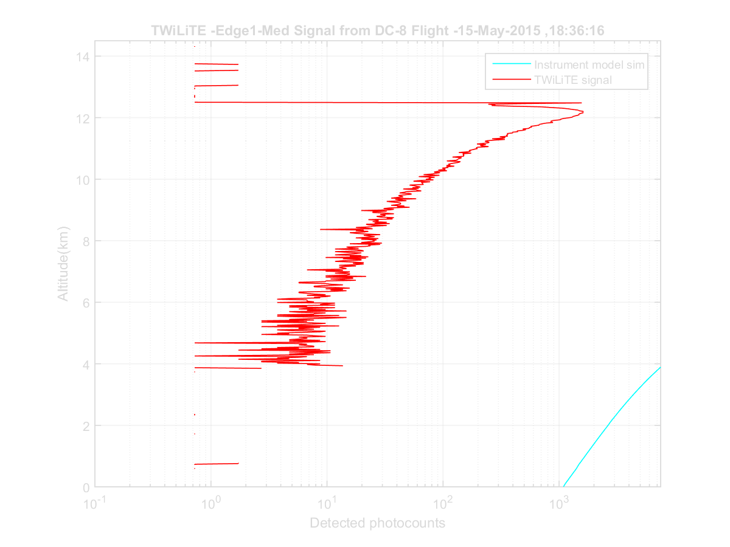
Edge 1 – Med Signal ~ 9%
May 15, 2015 Cycle 26

Slide 12
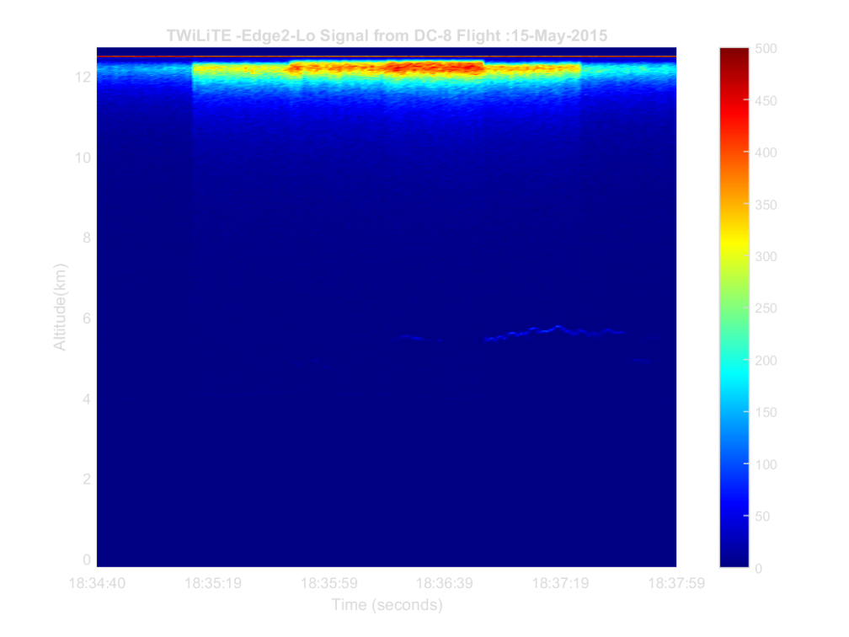
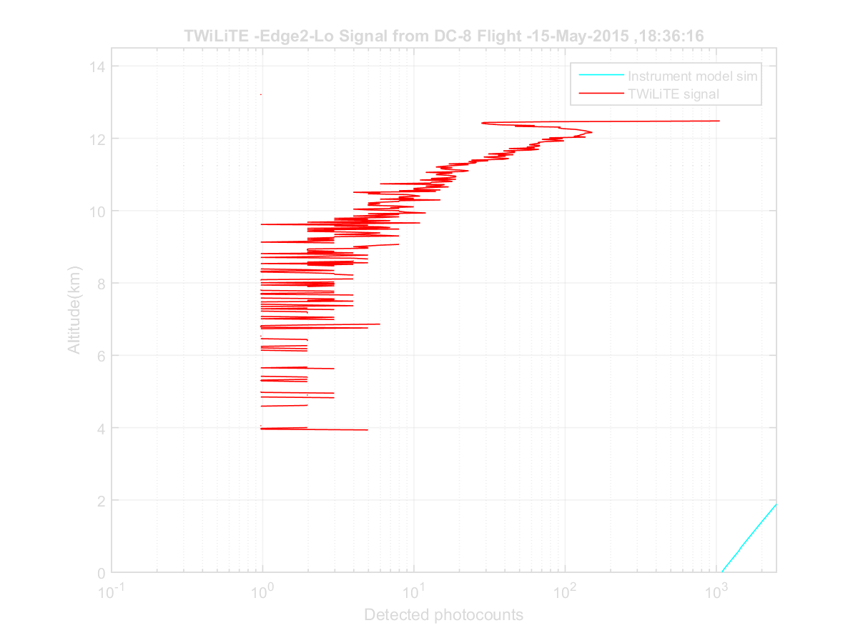
Edge 1 – Lo Signal ~1%
May 15, 2015 Cycle 26

Slide 13
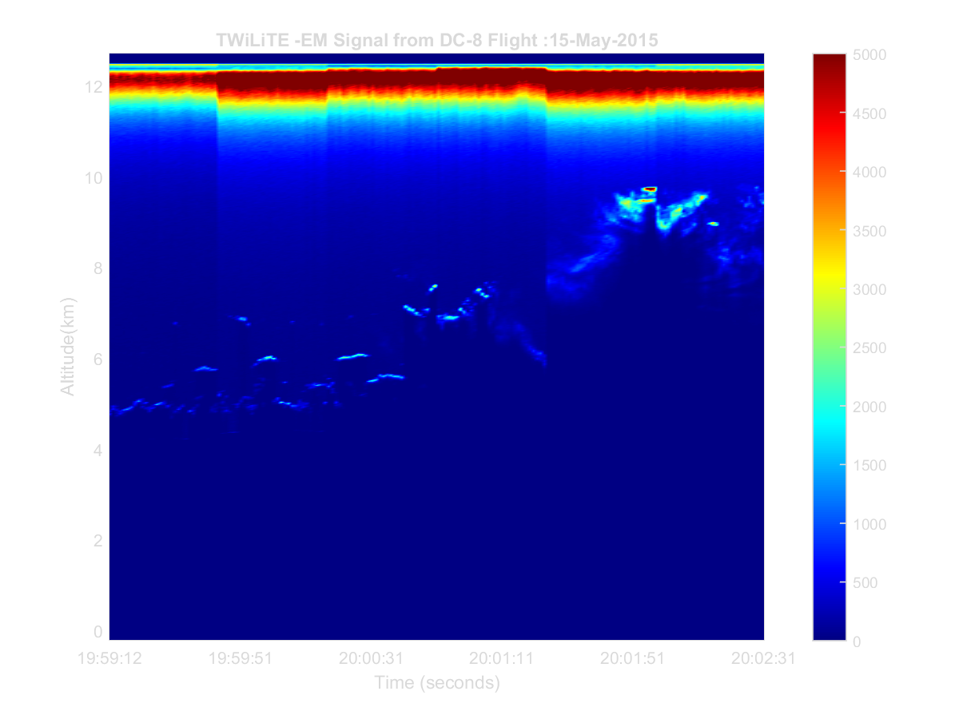
EM Channel – No etalon filters

Slide 14
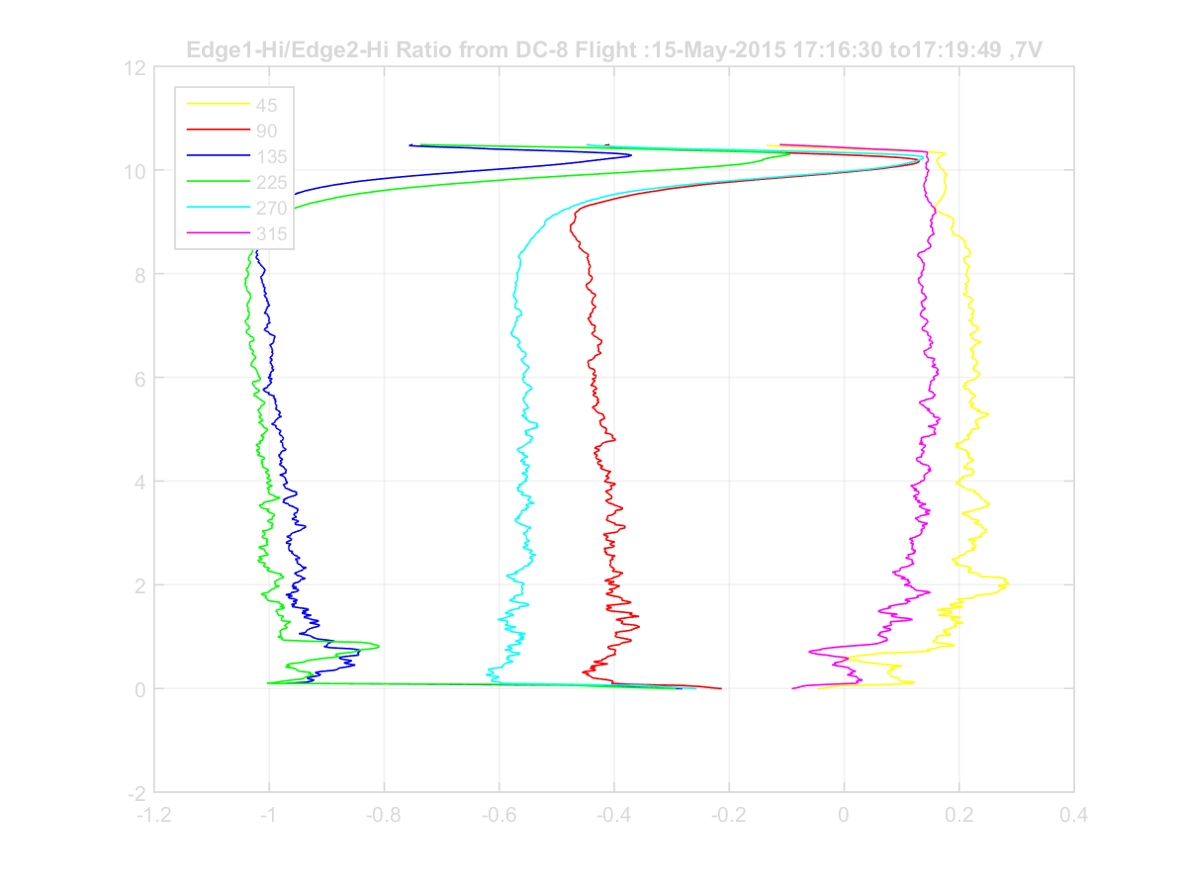
Edge 1 – Hi, Edge Ratio
May 15, 2015 Cycle 11
Z_{avg}=100 m
T_{avg}=30 s

Slide 15
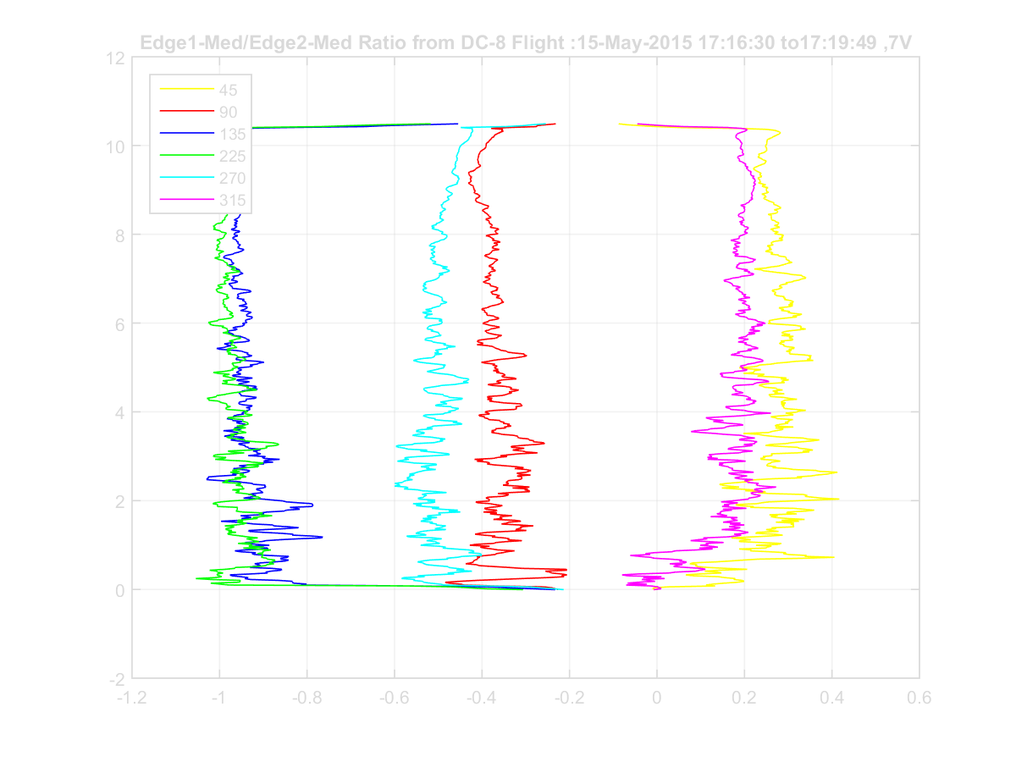
Edge 1 – Med, Edge Ratio
May 15, 2015 Cycle 11
Z_{avg}=100 m
T_{avg}=30 s

Slide 16
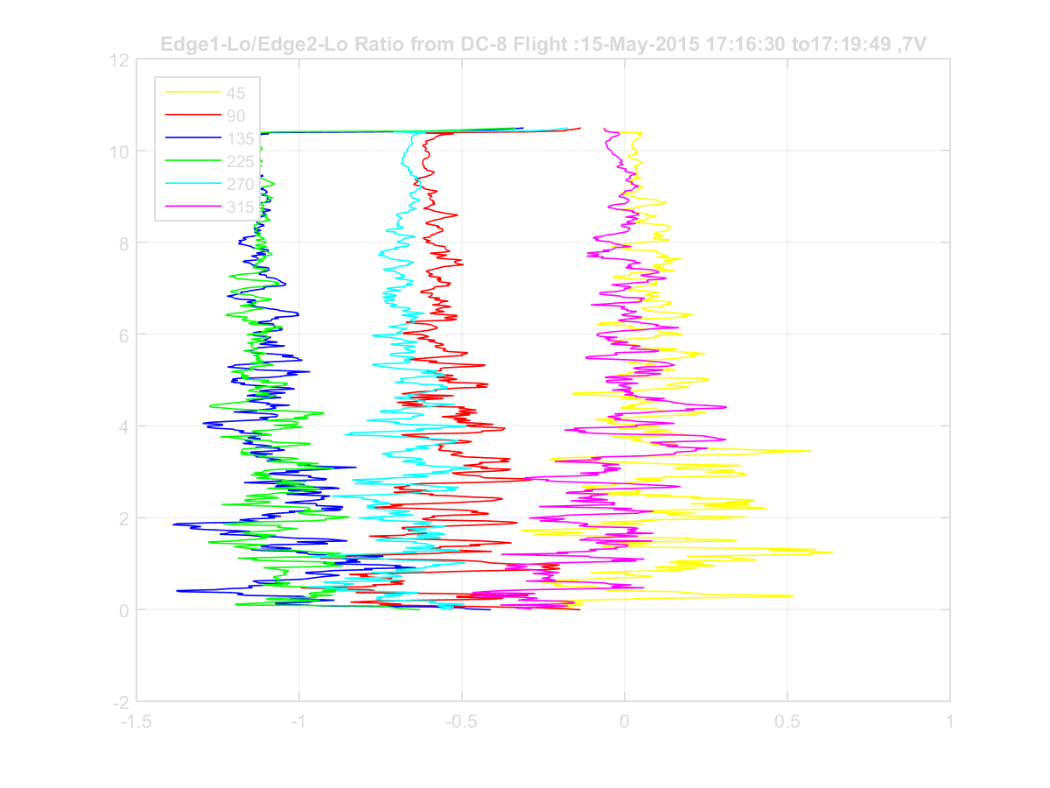
Edge 1 – Lo, Edge Ratio
May 15, 2015 Cycle 11
Z_{avg}=100 m
T_{avg}=30 s

Slide 17
May 27, 2015: TWiLiTE Processing Status
All 7 PMT channel signals have been processed for background correction, dead time correction.
Signal files have been time synched and merged with DC-8 navigation data and corrected for pitch, roll and instrument offsets determined from ocean surface returns at the six angles.
All etalon scan data have been analyzed and fitted to the instrument function.
Currently examining the Edge channel ratio data (proportional to LOS velocity: wind+aircraft). There are some issues with the etalon alignment drift due to temperature. There are also indications that the aircraft velocity pushes the dynamic range of the Edge filters particularly for the aft looking directions (135 deg and 225 deg azimuth). Additional analysis is required particularly for the etalon alignment drift.
Next steps-
  develop more detailed model of temperature effects on the etalon alignment and incorporate this into the calibration algorithms.
  process radial LOS wind data for the 6 directions.
  Generate u,v component wind profiles

Slide 18
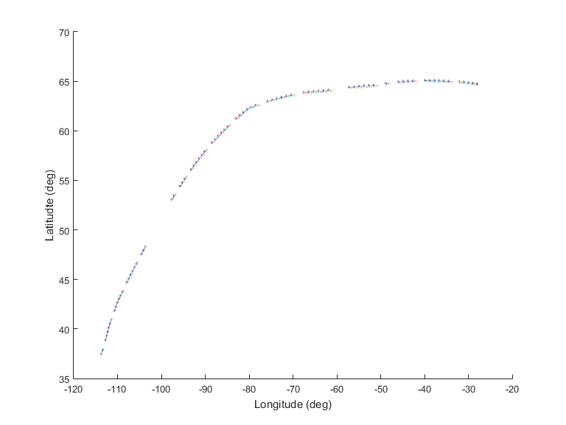
May 9, 2015 Polar Winds Transit Flight track with TWiLiTE scans
Palmdale, CA to Keflavik, Iceland
Complete scans: 77
Partial scans: 3
Etalon cals: 14

Slide 19
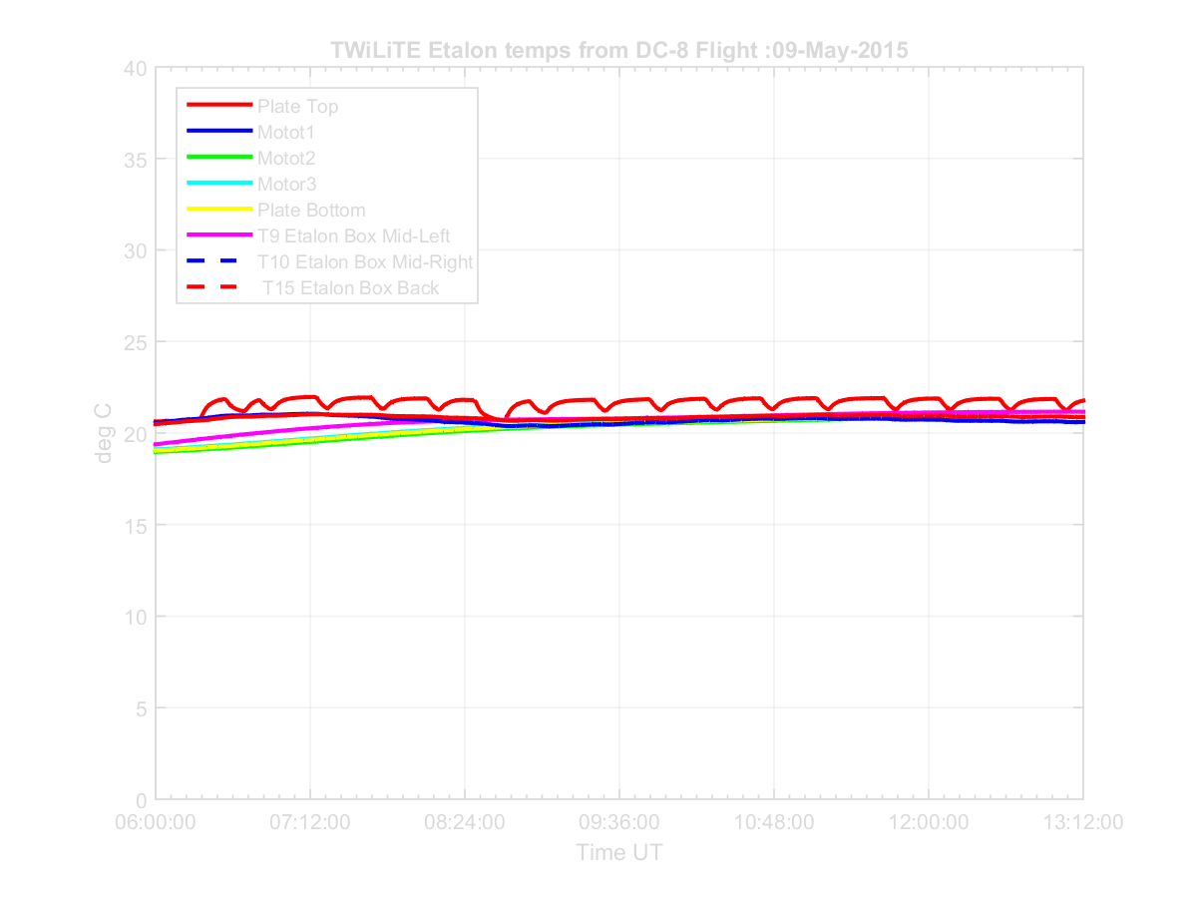
Internal Etalon Temperatures
May 9, 2015 Transit Flight

Slide 20
Etalon Gap Drift
May 9, 2015

Slide 21
May 15, 2015 Polar Winds Flight track with TWiLiTE scans
Complete scans: 46
Partial scans: 2
Etalon cals: 9

Slide 22
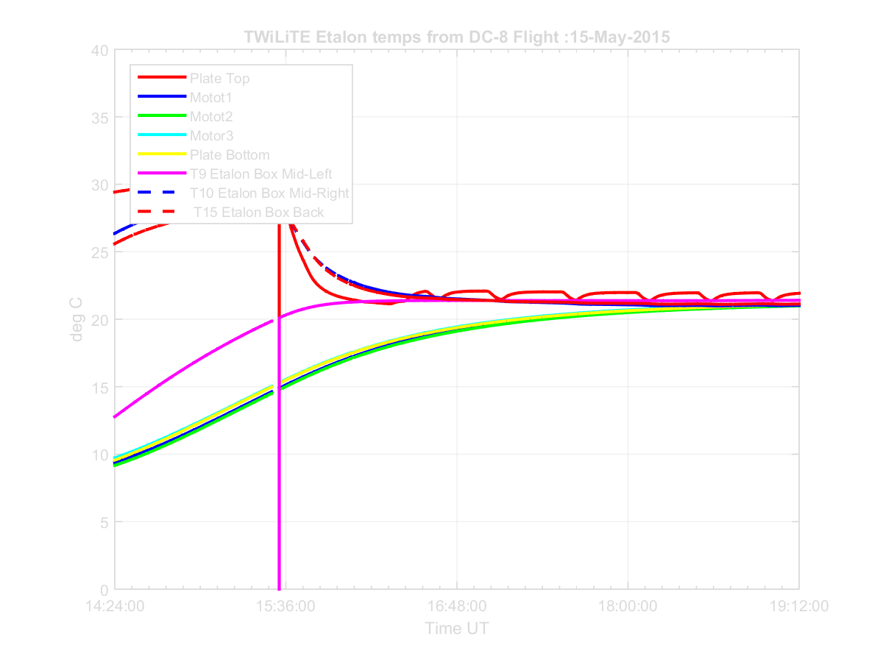
Internal Etalon Temperatures
May 15, 2015

Slide 23
Etalon Gap Drift
May 17, 2015

Slide 24
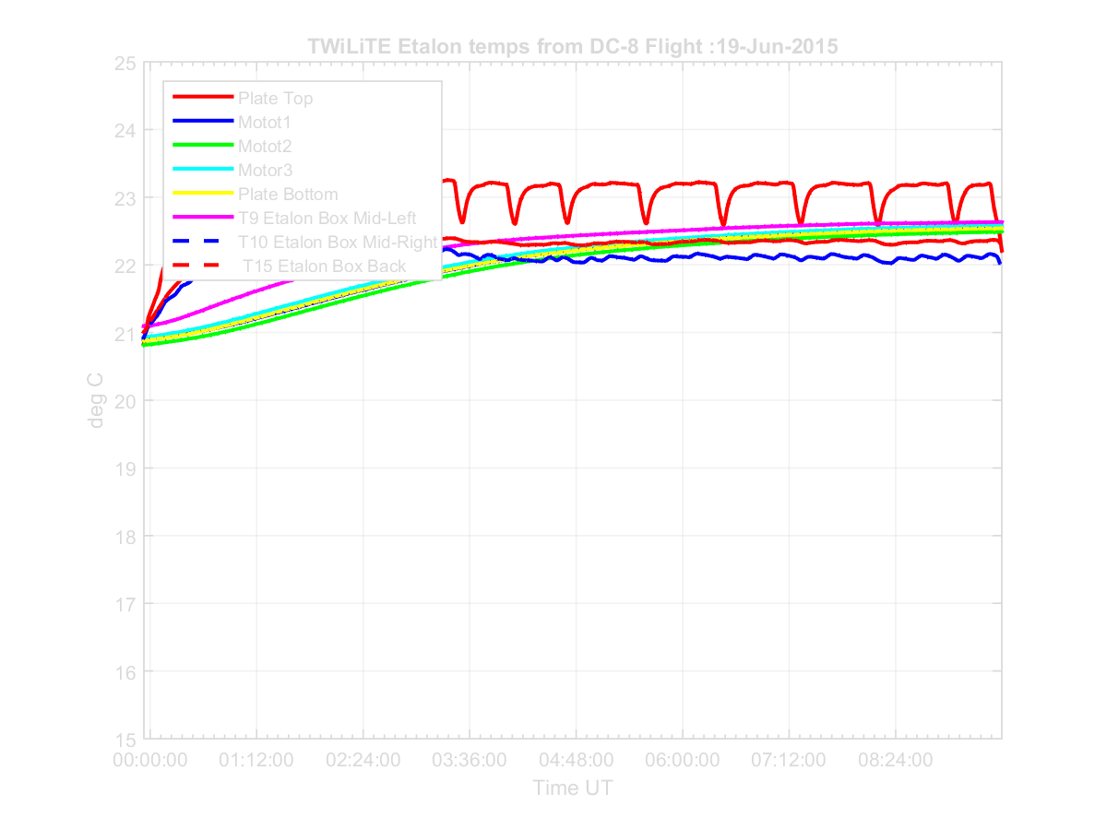
Internal Etalon Temperatures
PECAN June 19, 2015

Slide 25
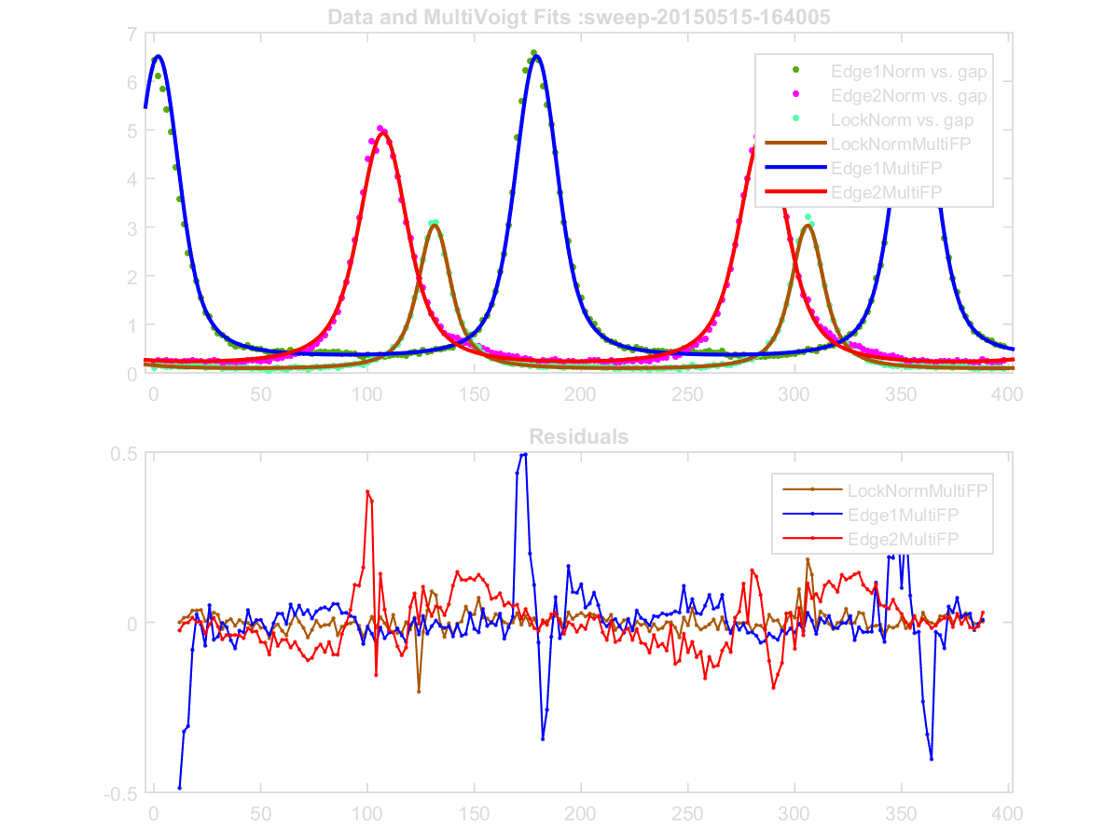
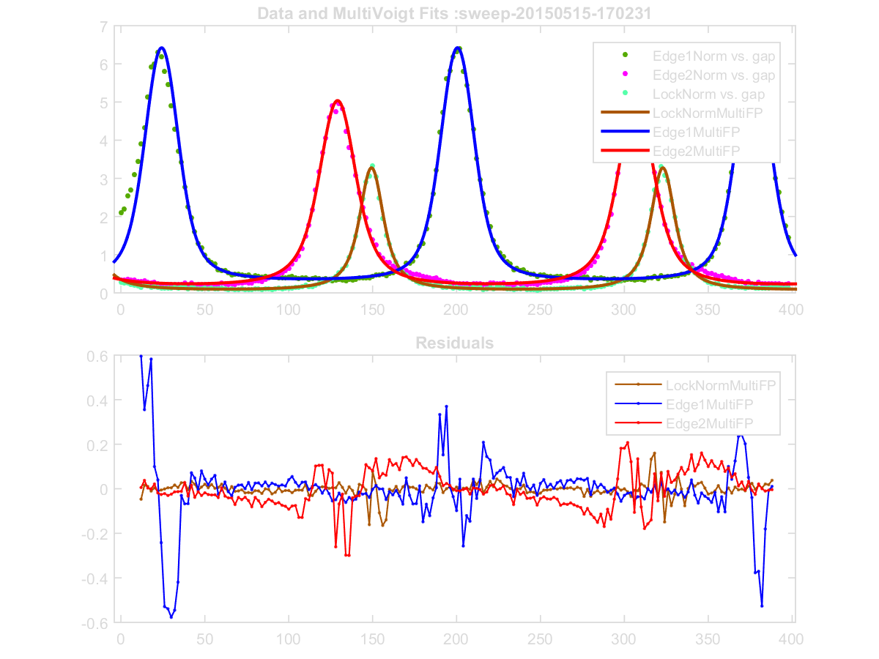
New Calibration Procedure – 2
1. Fit Start and Ending Etalon Scans for each data collection period
Start Etalon Scan
Data Collection
End Etalon Scan

Slide 26
PECAN
June 19, 2015

Slide 27
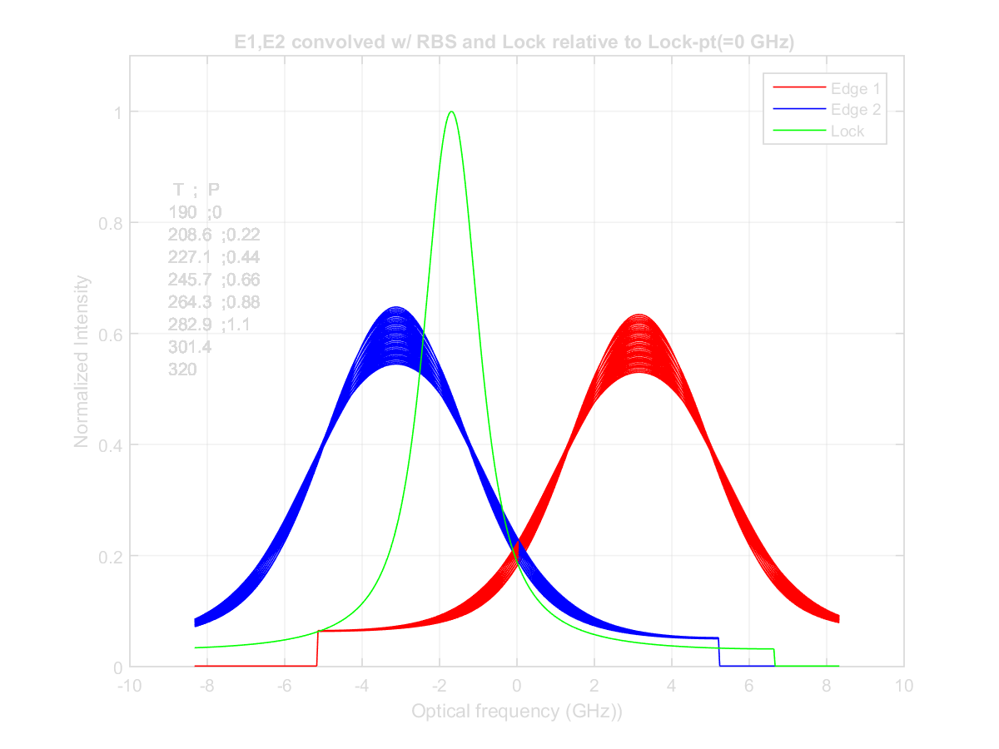
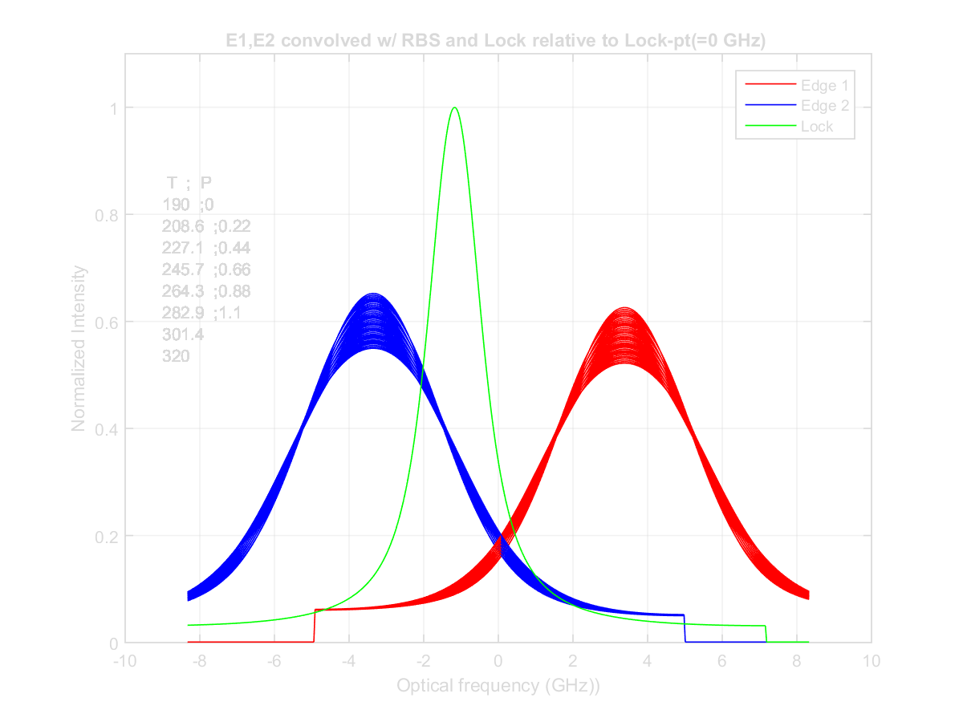
New Calibration Procedure – 1
1. Convlove Start and Ending Etalon Scans with RBS lineshape for range of T,P
Start Etalon Scan
Data Collection
End Etalon Scan

Slide 28
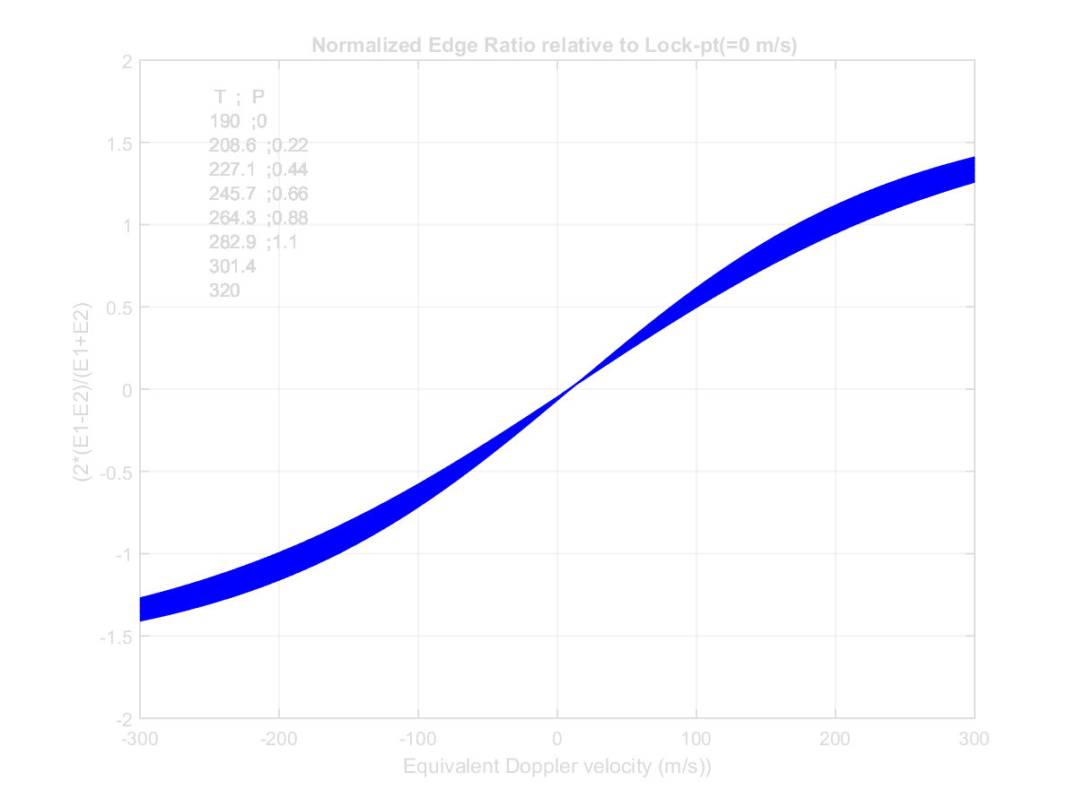
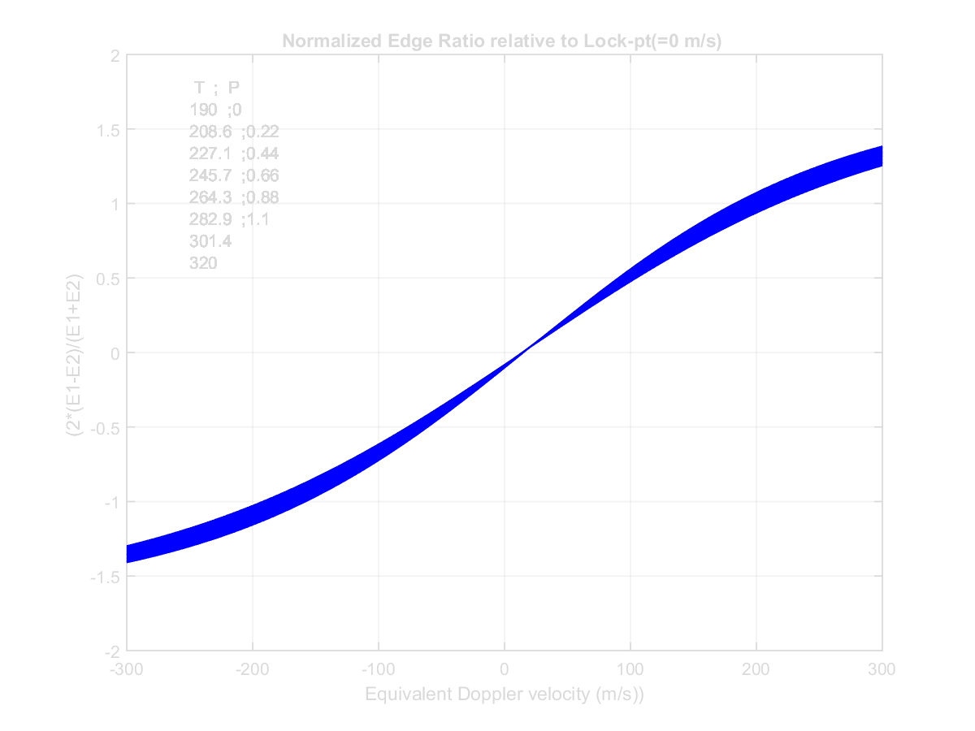
New Calibration Procedure – 3
1. Generate calibration curves 2*(E1-E2)/(E1+E2) for each etalon scan
Start Etalon Scan
Data Collection
End Etalon Scan

Slide 29
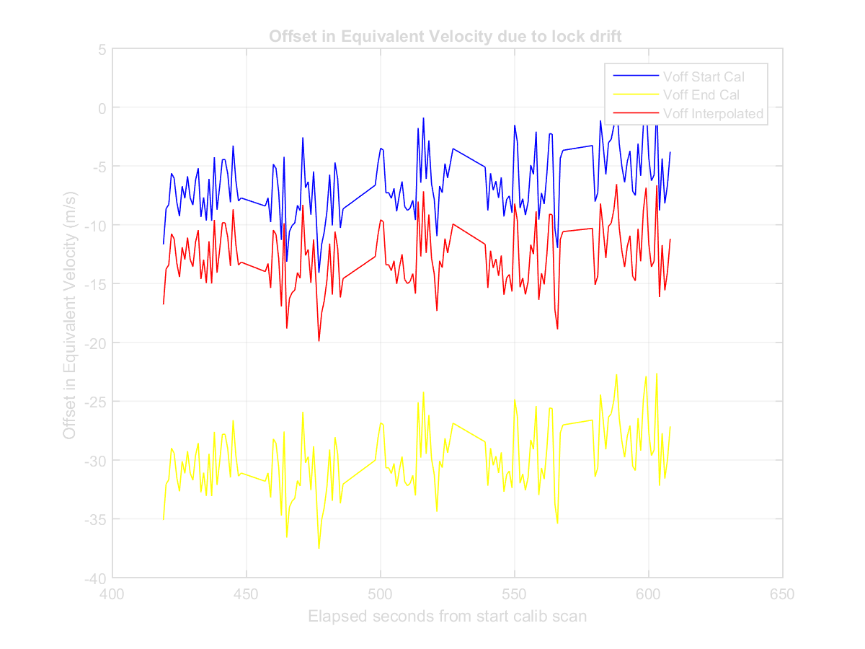
New Calibration Procedure – 4
Interpolate between Start and Ending Calibration curves for each 1 s profile
within the data collection period

Slide 30
Summary
Thermal environment presented major challenge for TWiLiTE. Etalon drifts of order 200 to 300 m/s equivalent velocity were observed as etalon slowly reached thermal equilibrium during flights.
Assumptions of etalon stability between periodic (~every 15 minutes) calibration scans, previously used in the TWiLiTE quick look analysis, are invalid for Polar Winds flights.
A new calibration procedure to use all etalon scans to dynamically calibrate each 1 sec profile.
This procedure has been successfully used in the analysis of TWiLiTE data collected from the ground during the PECAN field campaign in June-July, 2015
Currently implementing this procedure in the TWiLiTE airborne data analysis.

Slide 31
Next Steps
Continue implementation of the dynamic calibration procedure to correct for thermal etalon drift and mis-alignment
Produce corrected first look winds for all flights
Investigate use of Energy Monitor channel for aerosol and cloud measurements
Investigate use of Edge channel signals for determination of the atmospheric temperature.
Consider lessons learned from Polar Winds and PECAN to improve operations, especially thermal control, for future missions.

